Slide 1
FITNESS AI AGENT
IBM HACKATHON PROJECT
Presented By:
Student name : Joydeep De
College Name & Department : UEM, Kolkata, CSE

Slide 2
OUTLINE
Problem Statement
Technology used
Wow factor
End users
Result
Conclusion
Git-hub Link
Future scope
IBM Certifications

Slide 3
Problem Statement
With rising sedentary lifestyles and busy schedules, many individuals struggle to stay physically active, eat healthy, and maintain consistency in their wellness routines. Traditional fitness solutions often lack personalization, require expensive subscriptions, or fail to provide timely motivation—making it difficult for users to build sustainable habits.
There is a growing need for an accessible, intelligent, and user-friendly solution that can offer personalized fitness support based on individual preferences, goals, and constraints.

Slide 4
Technology used
IBM cloud lite services
Natural Language Processing (NLP)
Retrieval Augmented Generation (RAG)
IBM Granite model

Slide 5
IBM cloud services used
IBM Cloud Watsonx AI Studio
IBM Cloud Watsonx AI runtime
IBM Cloud Agent Lab
IBM Granite foundation model

Slide 6
Wow factors
Natural Language Interaction Engages users in a conversational, user-friendly manner.
Personalized Fitness & Meal Guidance Delivers tailored workouts and healthy meal suggestions based on user input.
RAG-Powered Intelligence Provides accurate, context-aware responses using Retrieval-Augmented Generation.
No-Equipment Workouts Accessible routines designed for all users without gym access.
IBM Granite Integration Built using enterprise-grade AI models for reliability and scalability.
Scalable and Modular Design Easily extendable with features like reminders or progress tracking.

Slide 7
End users
Students and Young Adults Looking for simple, home-based fitness and wellness guidance.
Working Professionals Seeking quick workouts and health tips to balance busy schedules.
Fitness Beginners Individuals starting their fitness journey who need personalized, low-barrier support.
Home-makers and Remote Workers Users with limited access to gyms or trainers.
Educational Institutions For promoting physical well-being among students through digital wellness agents.

Slide 8
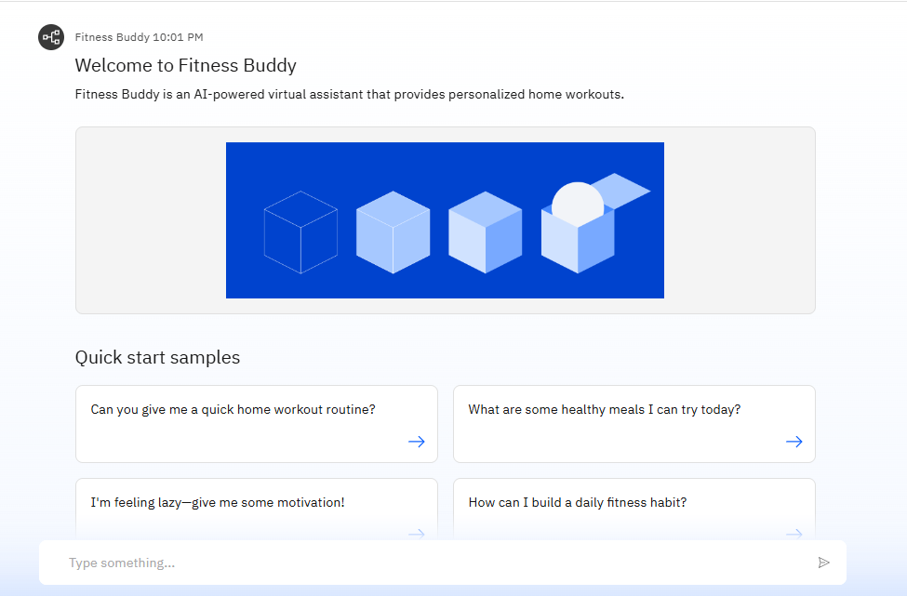
Results

Slide 9
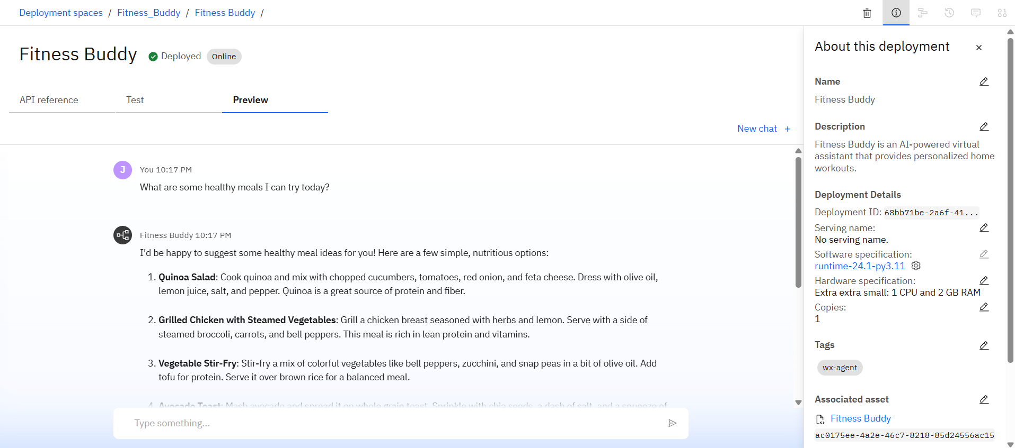
Results

Slide 10
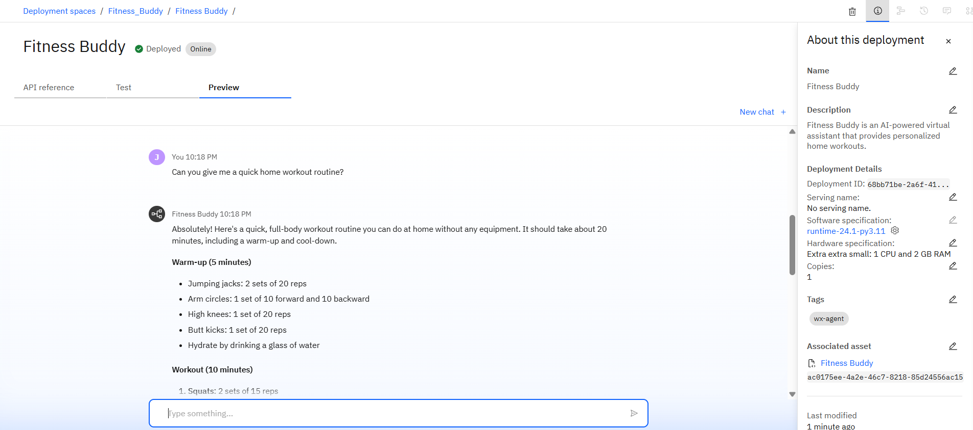
Results

Slide 11
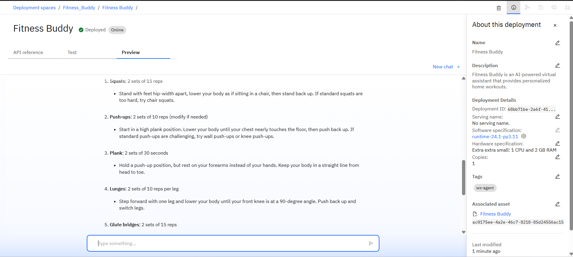
Results
Deployed AI Agent

Slide 12
Conclusion
The Fitness Buddy AI Agent demonstrates the potential of conversational AI in promoting healthier lifestyles through personalized, accessible, and engaging guidance. By integrating natural language interaction with intelligent workout and nutrition suggestions, the system offers a practical solution for users of all backgrounds. With its scalable design and AI-powered foundation, this project not only addresses current fitness challenges but also sets the groundwork for future enhancements in digital wellness support.

Slide 13
GitHub Link
https://github.com/joydeep1007/IBM-Internship.git

Slide 14
Future scope
Voice and Multilingual Support Enable voice interaction and regional language compatibility for wider accessibility.
Progress Tracking and Analytics Integrate user progress logs, habit streaks, and fitness dashboards.
Integration with Wearables Connect with fitness bands or smartwatches for real-time activity monitoring.
Daily Reminders and Notifications Implement push alerts for workouts, hydration, and meal times.
AI-Powered Adaptive Plans Dynamically update workout and diet plans based on user behavior and feedback.

Slide 15
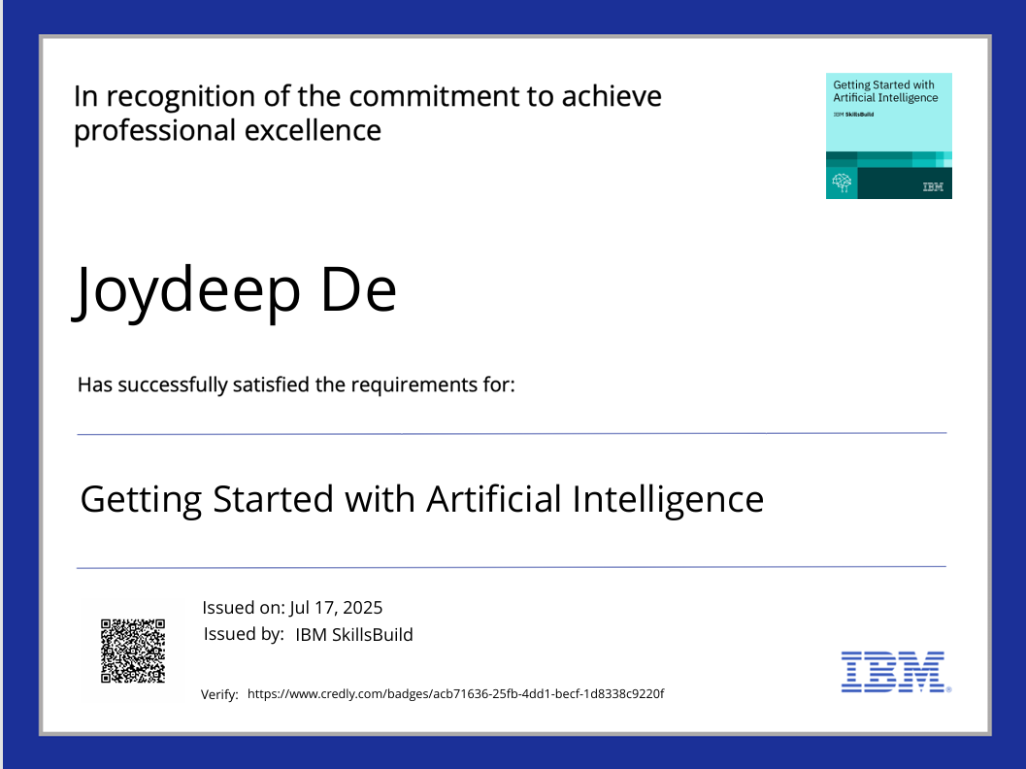
IBM Certifications

Slide 16
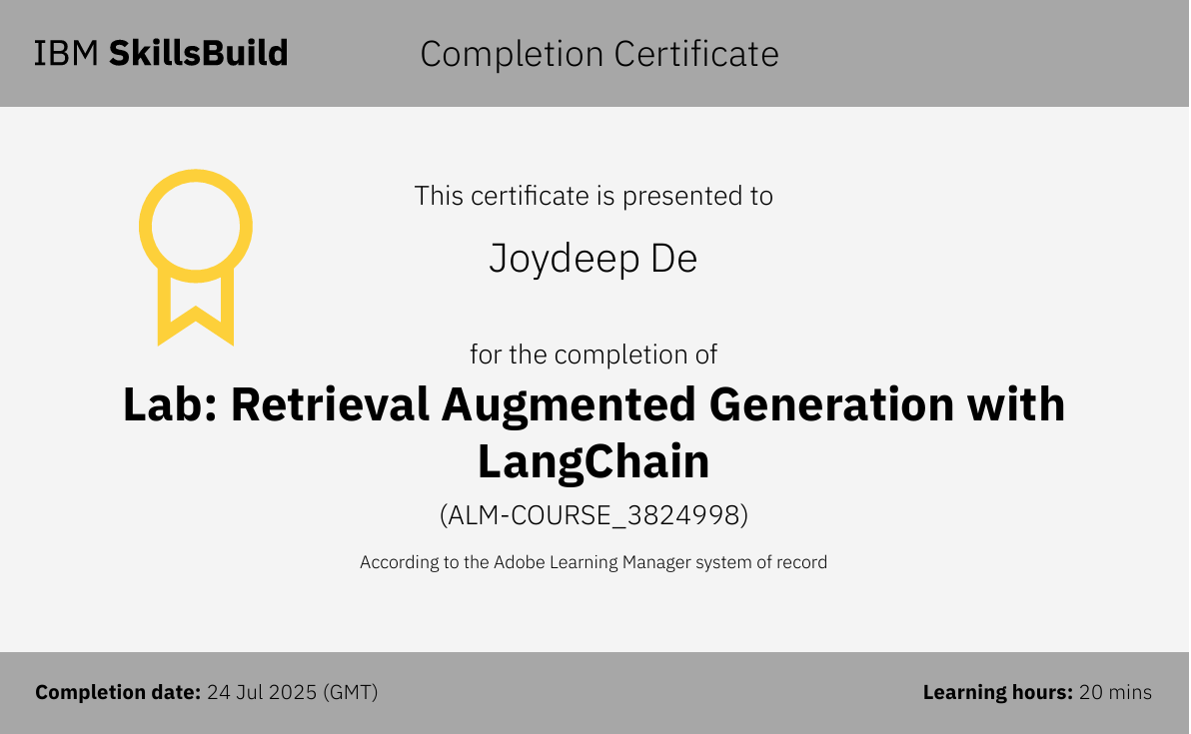

Slide 17
THANK YOU

